Slide 1



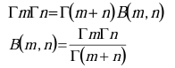




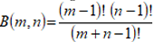
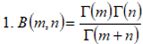
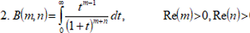
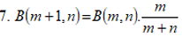
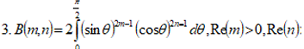
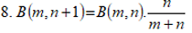
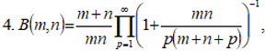
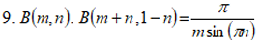


K. J. Somaiya College of Engineering, Mumbai – 400 077
(A Constituent College of Somaiya Vidyavihar University) Dept. of Science and Humanities
F.Y. B. Tech. Semester –II (2022-23)
Applied Mathematics-II
IA-II
Beta function and string theory
NAME : Akshat
ROLL NO. :16010122221
DIV: C3 BATCH: C3-1
Beta function and string theory.
Properties of Beta Function.
The beta function is symmetric i.e.; B(m,n)=B(m,n)
When m and n are positive integers, it follows definition of gamma function that:
In string theory, the beta function plays a crucial role in understanding the behavior of the theory at different energy scales. The beta function is a mathematical function that describes how the coupling constants in a quantum field theory change as the energy scale is varied.
The incomplete beta function is generalization of the beta function that replaces the definite integral of the beta function with an indefinite integral. The situation is analogous to the incomplete gamma function being a generalization of gamma function.
The Beta function was first studied by Euler and Legendre and was given its name by Jacques Bi-net just as the gamma function for integers describes Factorials, the gamma function can define a binomial coefficient after adjusting indices. The beta function was the first known scattering amplitude in string theory. First conjectured by Gabriele Veneziano.
It has many other forms, including:
An Italian theoretical physicist and the founder of string theory Gabriele Veneziano first conjectured the beta function as the Scattering amplitude in string theory.

Slide 2






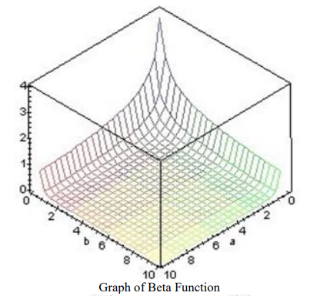
In the context of string theory, the beta function describes the running of the string coupling constant. The string coupling constant determines the strength of the interactions between strings. In perturbative string theory, the coupling constant depends on the characteristic length scale of the strings, which is related to the energy scale.
The beta function provides information about how the string coupling constant changes as we move to higher or lower energy scales. It tells us whether the coupling becomes stronger or weaker as we probe shorter or longer distance scales.
This information is crucial for understanding the renormalization group flow of the theory, which describes how the fundamental parameters of the theory evolve as we change the energy scale . By analyzing the beta function, string theorists can study the behavior of string theory at different energy scales and make predictions about its properties. For example, the beta function can be used to determine whether a string theory is asymptotically free or exhibits a fixed-point behavior. These properties have important implications for the ultraviolet and infrared behavior of the theory.
Overall, the beta function is a fundamental tool in understanding the behavior and properties of string theory at different energy scales, and it plays a crucial role in the study of renormalization group flow, anomaly cancellation, and the ultraviolet and infrared behavior of the theory.
References
https://www.ijsr.net/archive/v9i11/SR201122201029.pdf
http://sces.phys.utk.edu/~moreo/mm08/Riddi.pdf

